Slide 1


Music Notes Extraction using FFT
Under the Guidance of
Prof. Sadanand Kulkarni
TEAM DETAILS:
Sl. No. | Name | SRN.
1 | Chidambar Patil | 02FE21BEC026
2 | Komal Melavanki | 02FE21BEC042
3 | Laxmi Kammar | 02FE21BEC044
4 | Praveen Magadum | 02FE21BEC064
Department of Electronics and Communication Engineering,
KLE Technological University’s Dr. M. S. Sheshgiri College of Engineering and Technology, Belagavi
1

Slide 2
CONTENTS :
SI. NO | CONTENTS
1 | Problem Statement
2 | Introduction
3 | Fast Fourier Transform
4 | Block Diagram
5 | Methodology
6 | Dataset
7 | Obtained Results

Slide 3
Problem Statement
Develop a system that extracts musical notes from an audio signal using the Fast Fourier Transform (FFT) technique.
<
>

Slide 4
INTRODUCTION
A Song contains two things, vocal and background music, where the characteristics of the voice is dependent on the singer and in the case of background music, it involves a mixture of different musical instruments like piano, guitar, drum, etc.
Extracting the characteristic of a song becomes more important for various objectives like learning, teaching, and composing. This project takes the song as an input, extracts the features, and detects and identifies the notes, each with a duration.
The algorithm involves signal preprocessing, windowing, FFT computation, and post-processing.
The algorithm's versatility allows it to handle different instruments and styles, making it applicable across diverse audio signals.
<
>

Slide 5
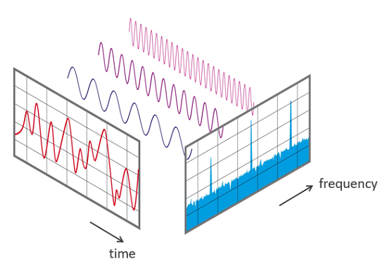
Fast Fourier Transform
The Fast Fourier Transform (FFT) in Digital Signal Processing (DSP) is an algorithmic technique used to efficiently compute the Discrete Fourier Transform (DFT) of a sequence, typically a digital signal.
FFT allows us to convert a signal from its time-domain representation into its frequency-domain representation.
FFTs are used for fault analysis, quality control, and condition monitoring of machines or systems.
<
>
a) View of signal in the time and frequency domain

Slide 6
Literature Survey
Sl No. | Paper Title | Objective | Methods | Limitations
1 | Musical Notes Identification using Digital Signal Processing.(2015) | In this Paper , the frequencies of a piano song is detected, corresponding notes are identified with duration. | Fast Fourier Transform | The method used here for note identification is not optimised than previously used methods.
2 | Automatic Music Transcription: An Overview. (2019) | In this paper, we provide a high-level overview of Automatic Music Transcription, linking AMT to other problems found in the wider field of digital signal processing. | Recurrent Neural Networks | Challenges of Creation of a “complete” music transcription system and towards unlocking the full potential of music signal processing technologies
3 | Features extraction for music notes recognition using hidden markov model. (2007) | This paper shows how a suitable parameterization and adequate HMMs topology make a robust recognition system of musical notes. | Hidden markov models | A suitable adequate models have led to a robust basic recognition of musical notes in cases of multi-instrumental recognition conditions.
<
>

Slide 7
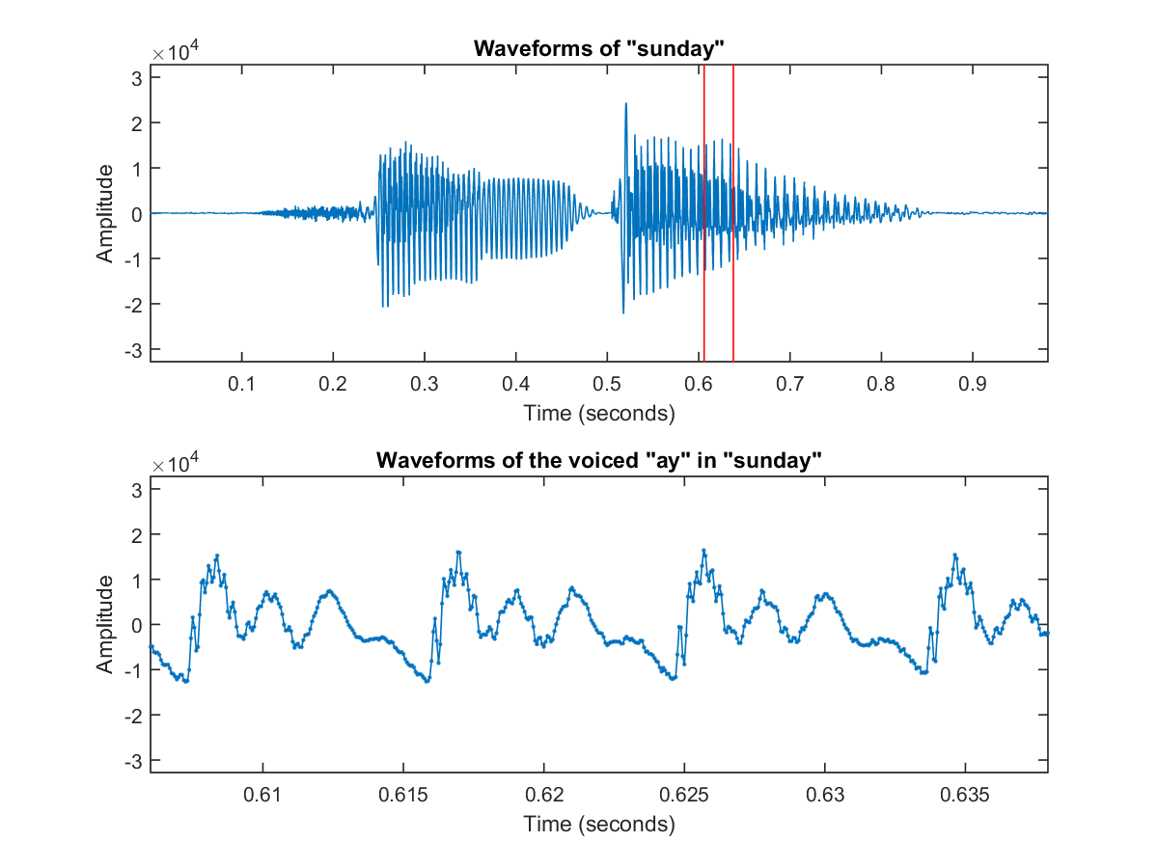
Characteristics of Audio signals
Time-varying: Audio signals represent sound pressure variations over time, constantly changing with the sound itself.
Frequency content: Human hearing typically perceives frequencies between 20 Hz and 20 kHz. DSP techniques often analyze and manipulate specific frequency ranges within this spectrum.
Non-stationary behavior: The frequency content and amplitude of audio signals often change over time, requiring time-frequency analysis techniques in DSP.
Non-linearity: Real-world sounds often exhibit non-linear behavior, requiring specialized DSP algorithms for accurate manipulation and synthesis.
Sampling and quantization: To digitize audio, continuous analog signals are sampled at discrete points in time and quantized to discrete values, introducing trade-offs in fidelity and data size.
<
>

Slide 8
Dataset used for project
The data used in this project is mentioned below:
Fur Elise Slow Piano Dataset
Raw Music file
<
>

Slide 9
Block Diagram
Import Audio Signal
Preprocessing
Feature Extraction
<
>
Recognised Notes
Classification

Slide 10
Methodology
Import Audio File
Set the Parameters
Applying the FFT
<
Down sampling
>
Applying Threshold to find notes
Finding the frequency of each notes and play back notes
Results

Slide 11
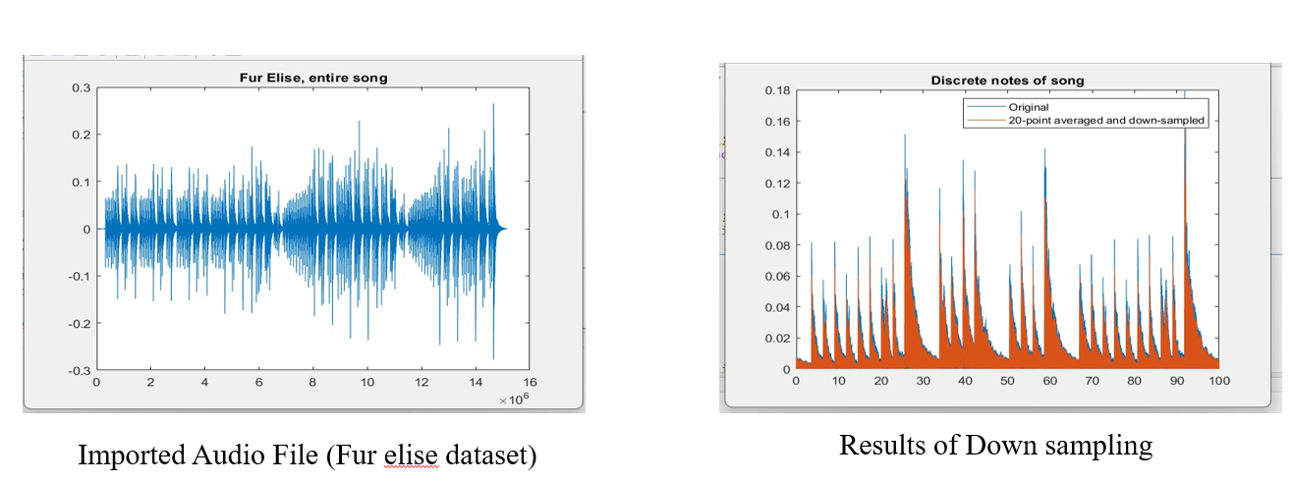
Obtained Results
<
>

Slide 12
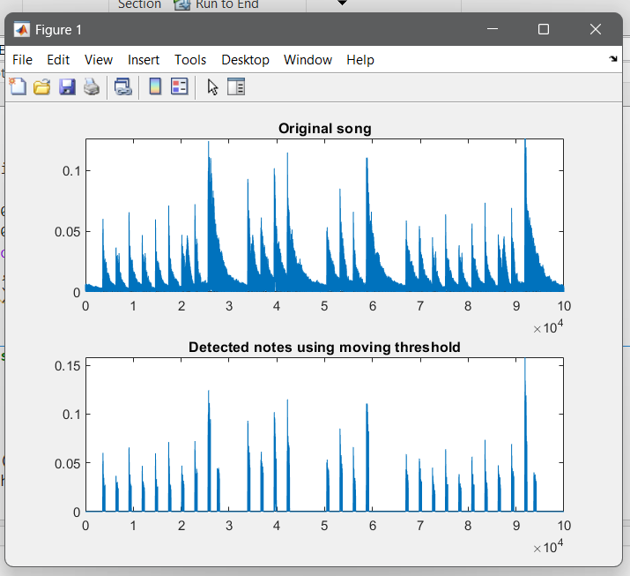
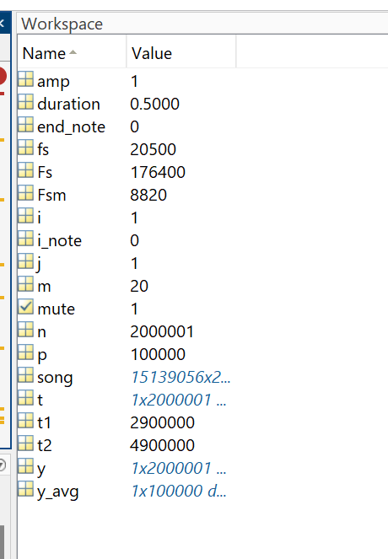
Obtained Results
<
>
Results of moving threshold to find the notes
Converted notes stored in an array

Slide 13
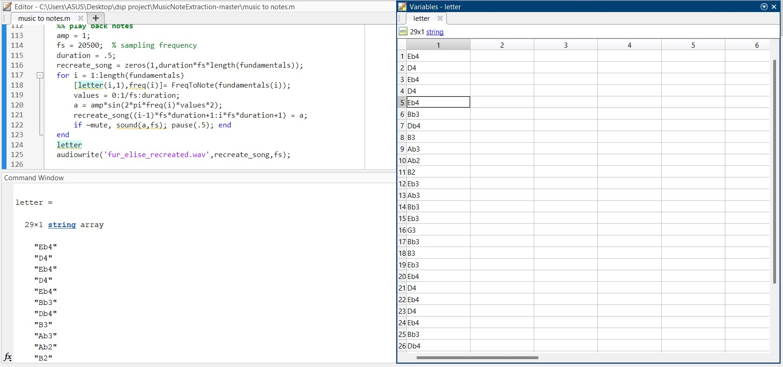
<
>
Converted notes from Audio file which is stored in an array

Slide 14
Conclusion
The application of Fast Fourier Transform (FFT) in digital signal processing for music notes extraction has demonstrated its efficacy in dissecting audio signals into their constituent frequency components.
Through this project, we have successfully employed FFT alongside signal pre-processing techniques to extract musical notes from audio files.
The process involved several key steps: loading the audio file, pre-processing to enhance signal quality, applying FFT for frequency analysis, identifying peaks corresponding to musical notes, and mapping these frequencies to note representations.
<
>

Slide 15
THANK YOU
<
>

